Slide 1

UNIVERSITY INSTITUTE OF TECHNOLOGY
RAJIV GANDHI PROUDOYOUGIKI VISHWAVIDYALAYA
BHOPAL,MP
MINOR PROJECT
ON
“RESULT PROCESSING SYSTEM”
SUBMITTED BY : ANUJ KUMAR KAUSHAL
ENROLLMENT NO : 0101CA191002

Slide 2
CONTENTS ->
About the Project
Objectives
Technologies Used
Work Flow
Tables
Front-end
Conclusion
Bibliography

Slide 3
ABOUT THE PROJECT :-
This project is basically aimed to generate a results of students of an institutes based on their academics and examination marks criteria.
The system is an application that can be accessed throughout the institute with a proper login provided.
This system can be used as an application to manage the student information with their marks scored in the examination.
Students can check their results by entering their enrollment no and semester.
This system is totally based on java and sql that uses java database connectivity to generate the result.
There are two main portal i.e. Admin portal and Student portal.
In admin portal, only faculty will access and record all the student information and marks details.
In student portal, Student check their results by entering their enroll no and semester.

Slide 4
OBJECTIVE :-
The primary objective of this project is to generate the result of students based on their academic performance.
Project provides the facility to maintain the details of the Students and faculty. Students can check their result and access their marksheet.

Slide 5
TECHNOLOGY USED :-
This project is totally a Java based project. Java is used as a front-end tool and MySQL as a back-end tool.
Database-> MYSQL
Software-> NETBEANS IDE 8.2.
Coding-> JAVA

Slide 6
WORK FLOW :-
START
ADMIN
STUDENT
VERIFY
NO
ENTER USERNAME AND PASSWORD
RESULT FORM
YES
MARKSHEET
STUDENT INFORMATION
FACULTY INFORMATION
MARKS INFORMATION
STUDENT DETAILS
FACULTY DETAILS
MARKS DETAILS
STOP

Slide 7
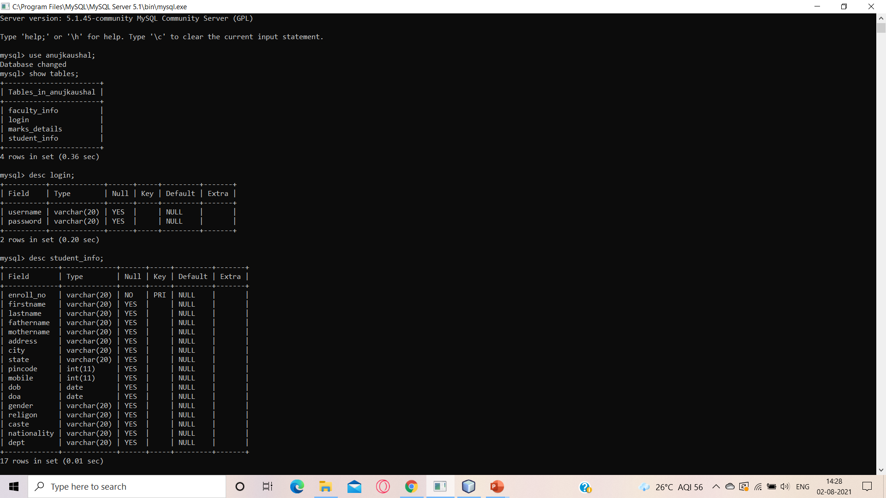

TABLES :-
LOGIN :-

Slide 8

STUDENT INFO :-

Slide 9
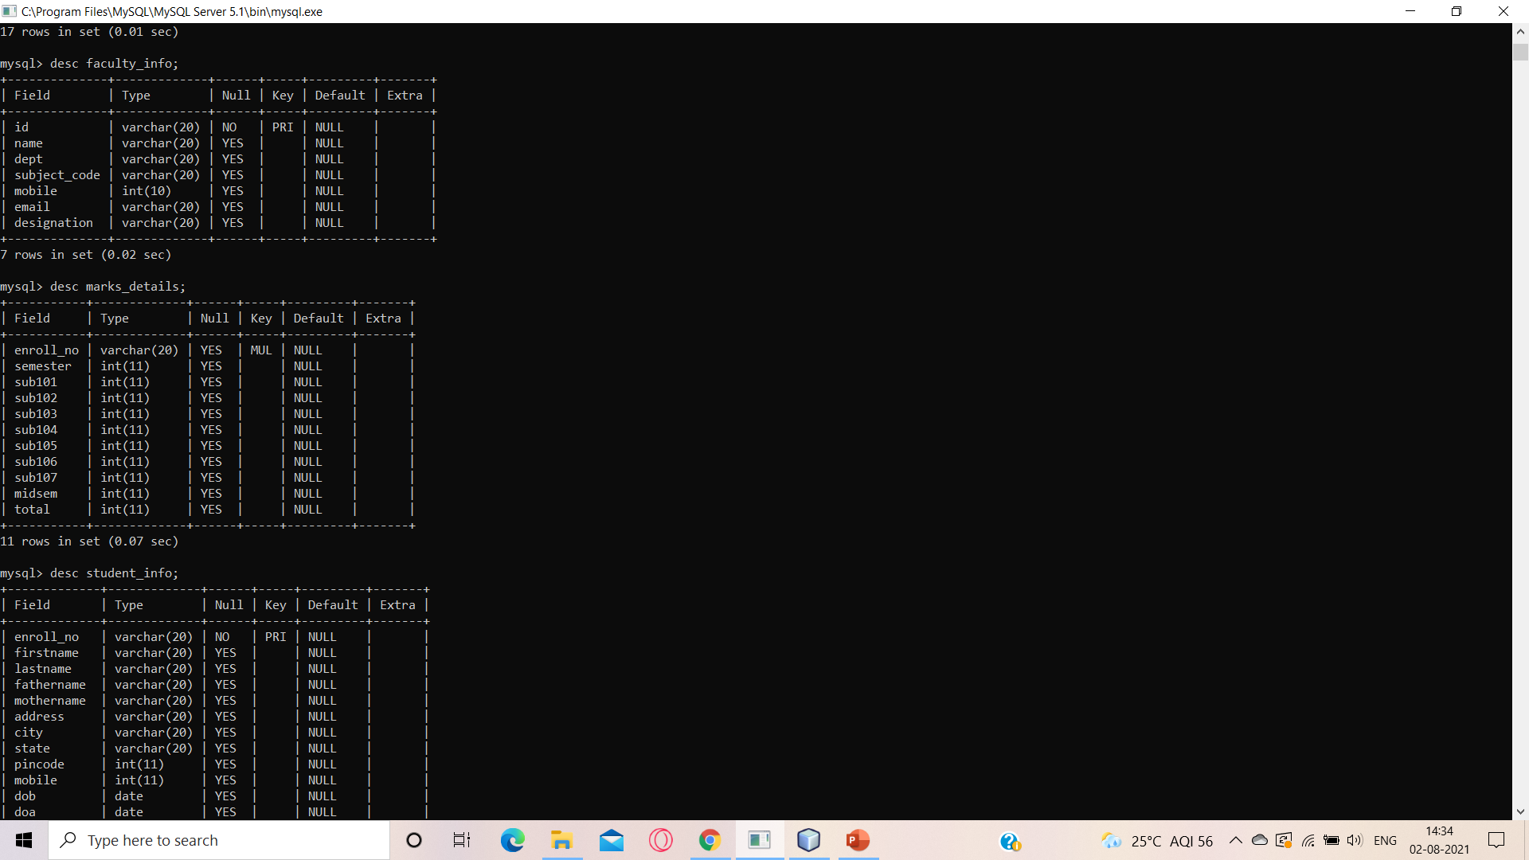

FACULTY INFO :-
MARKS DETAILS :-

Slide 10
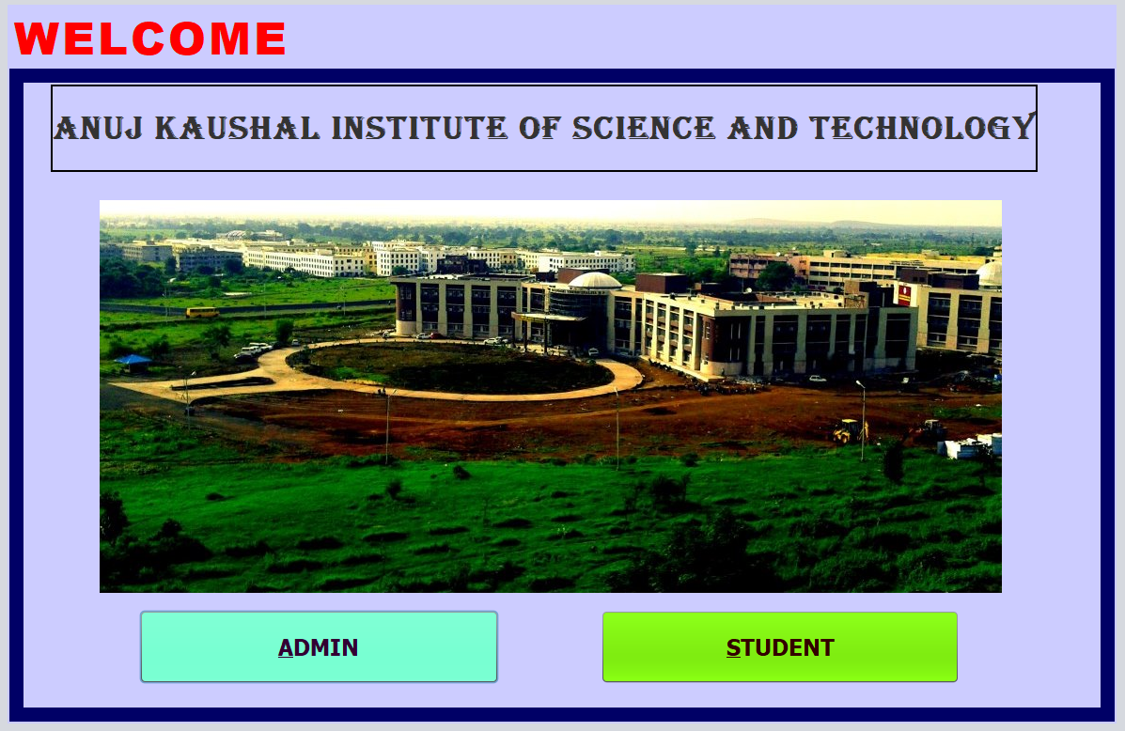
FRONT-END :-
INDEXPAGE

Slide 11
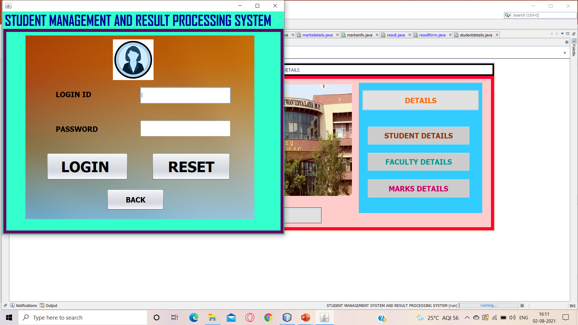
ADMIN PAGE :-

Slide 12
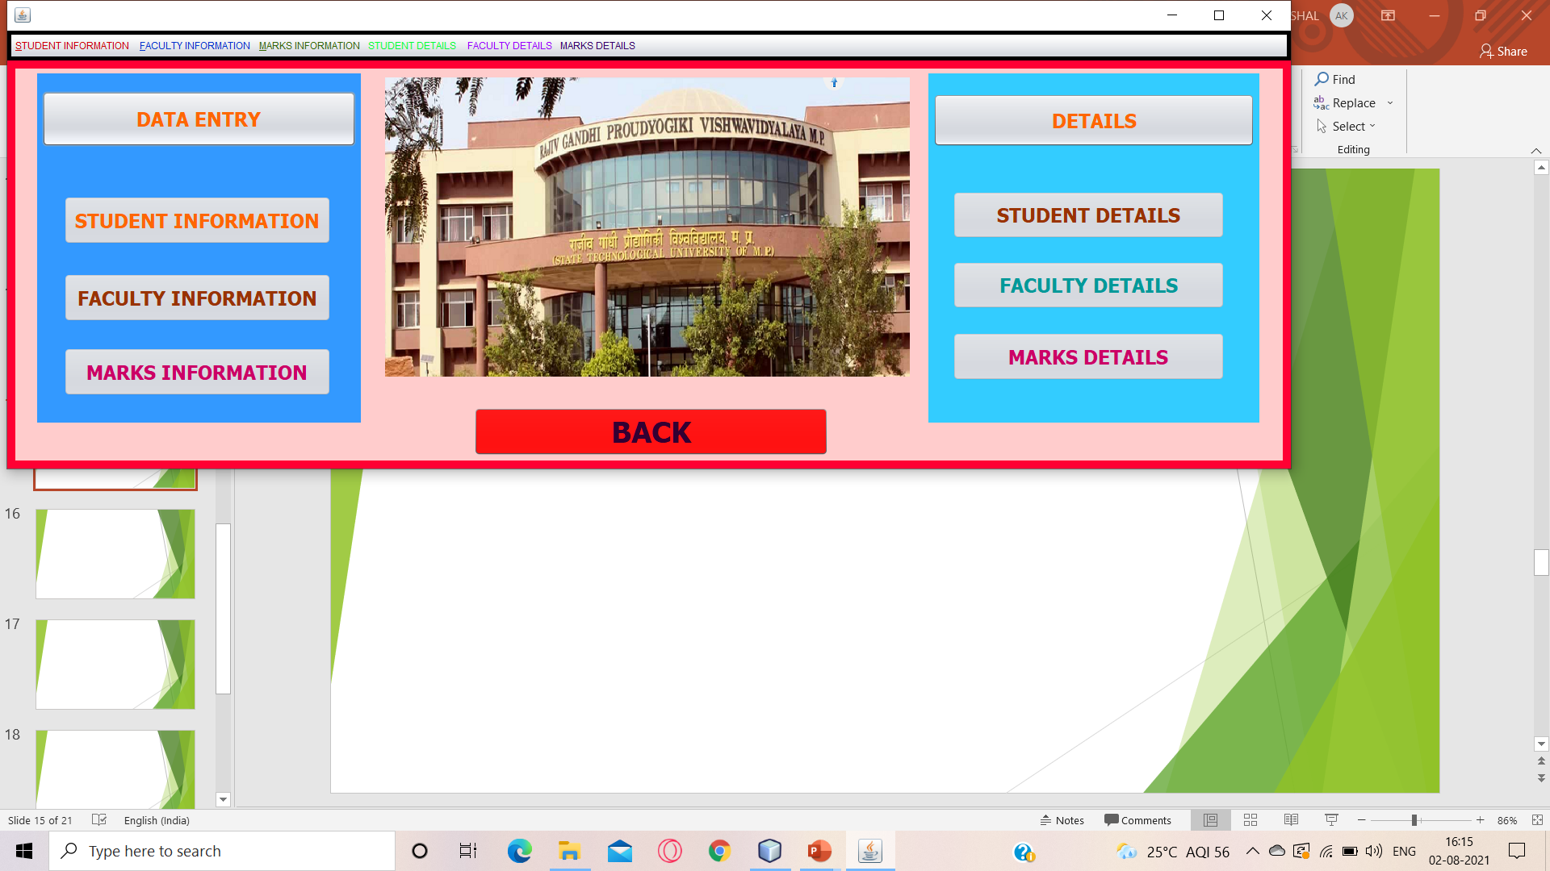
FRONTPAGE :-

Slide 13
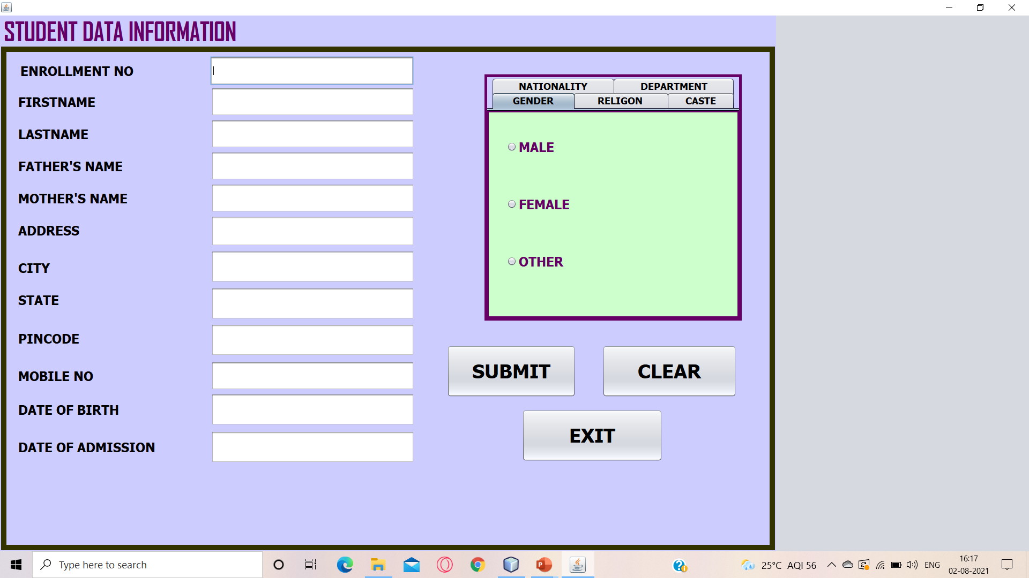
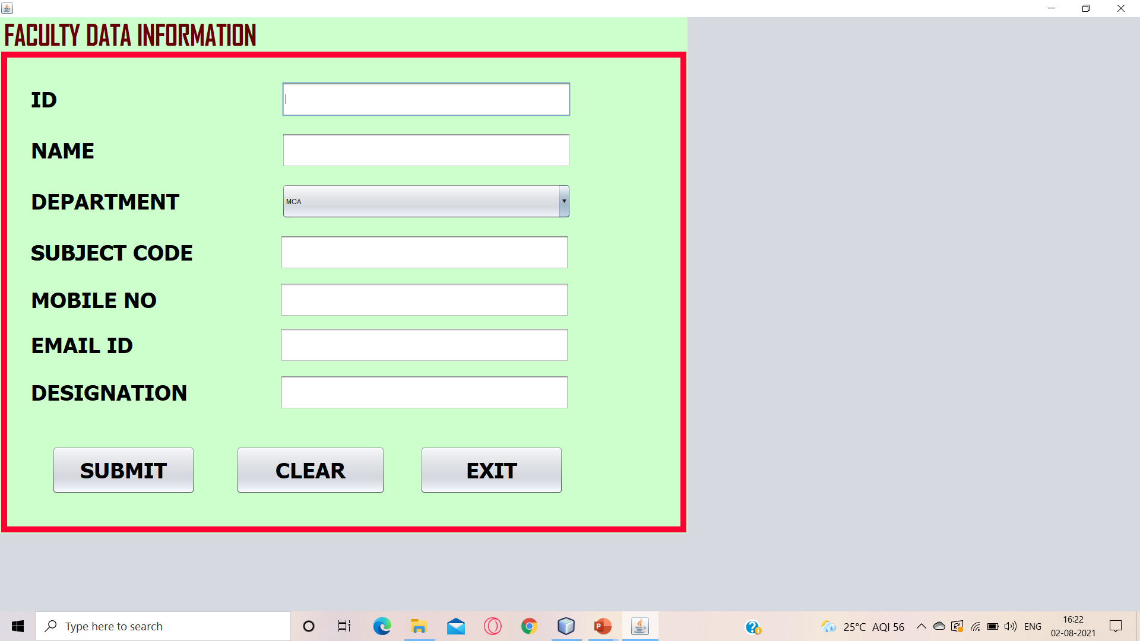
STUDENT INFORMATION :-
FACULTY INFORMATION :-

Slide 14
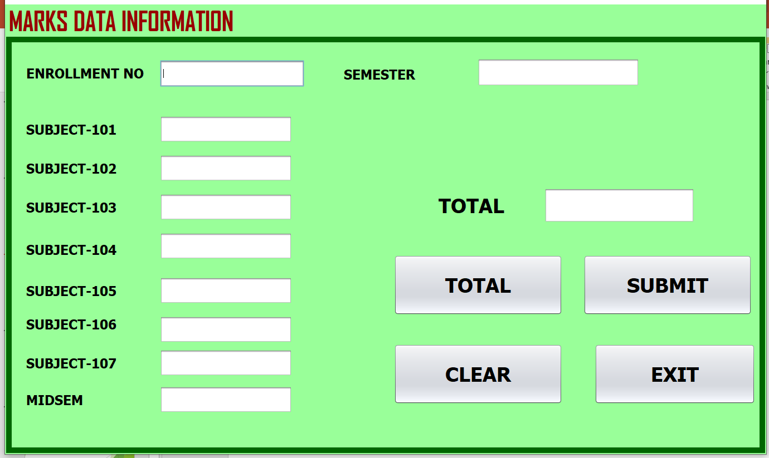
MARKS INFORMATION :-

Slide 15
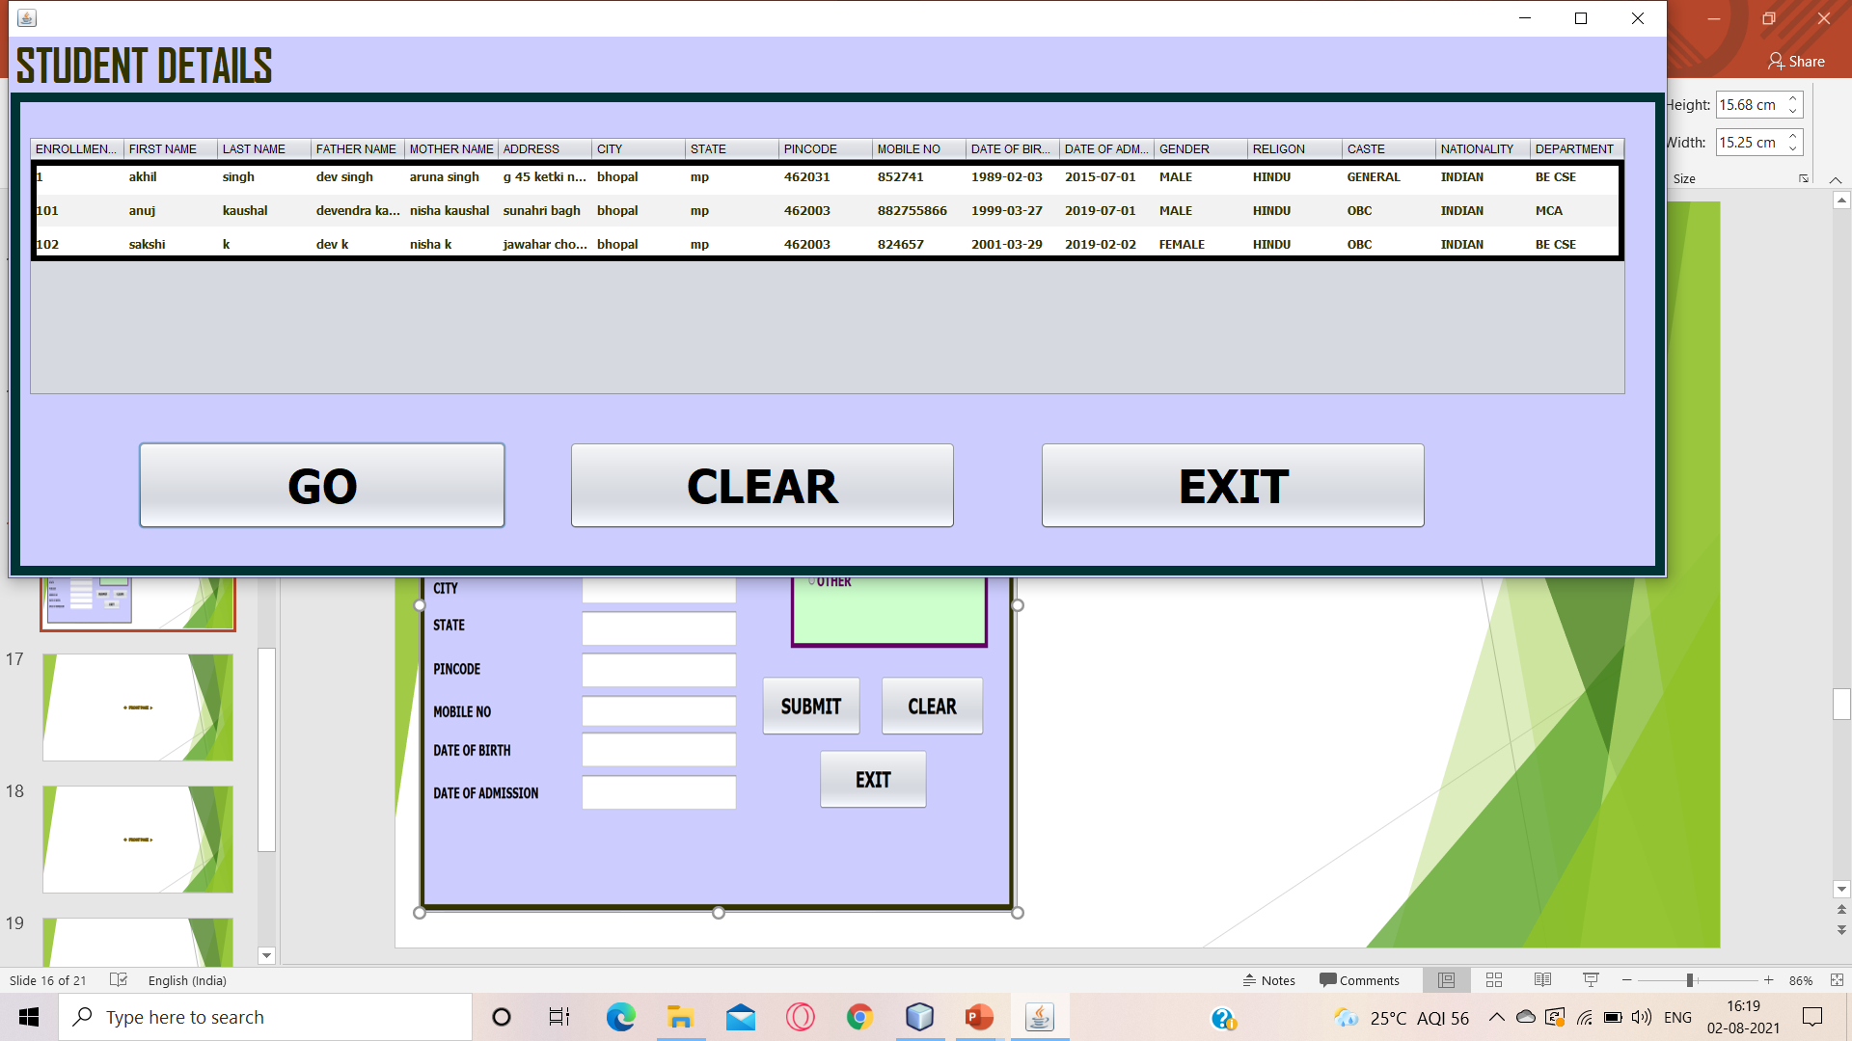
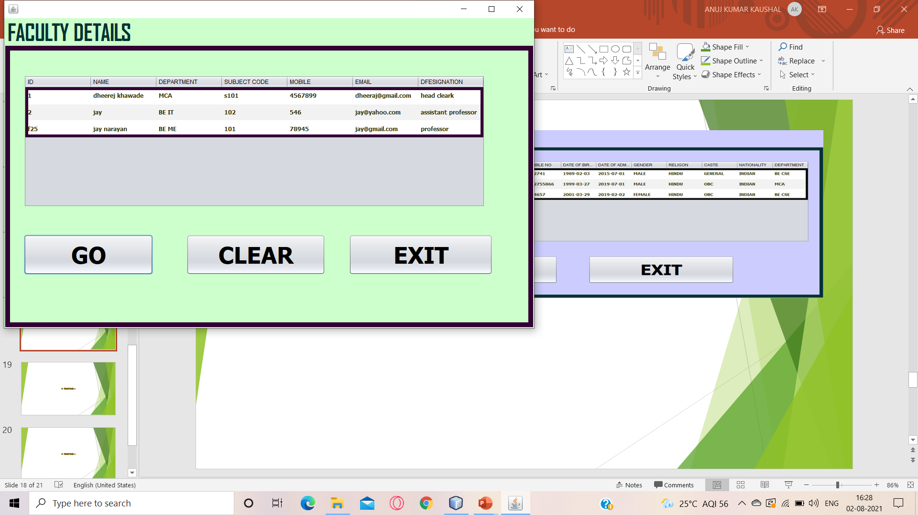
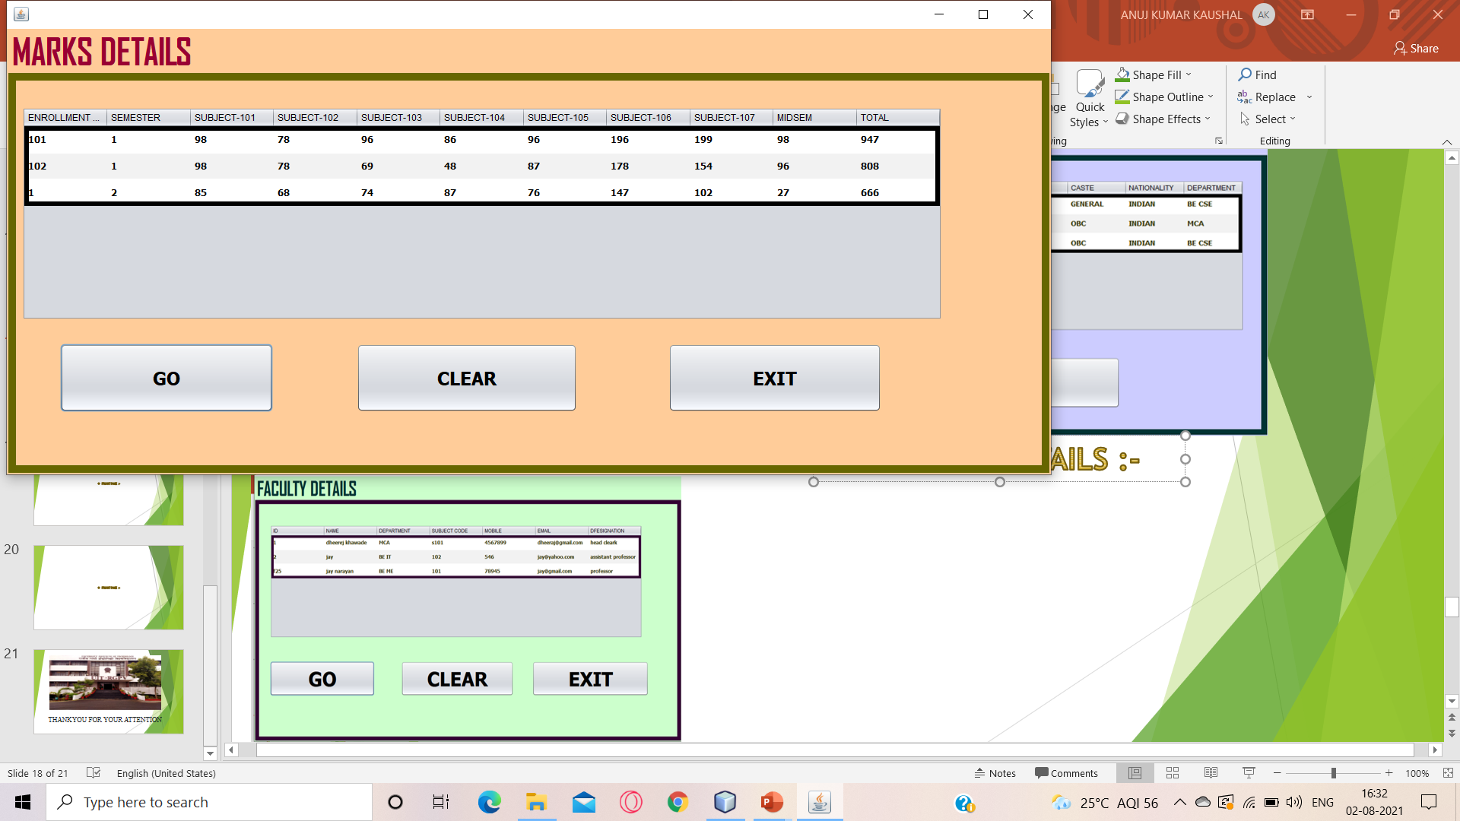
STUDENT DETAILS :-
FACULTY DETAILS :-
MARKS DETAILS :-

Slide 16
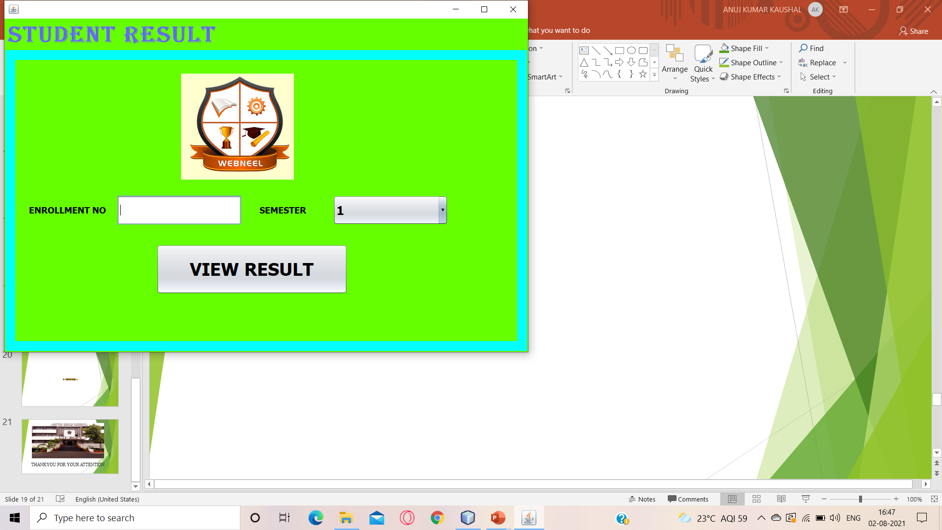
STUDENT PAGE :-

Slide 17
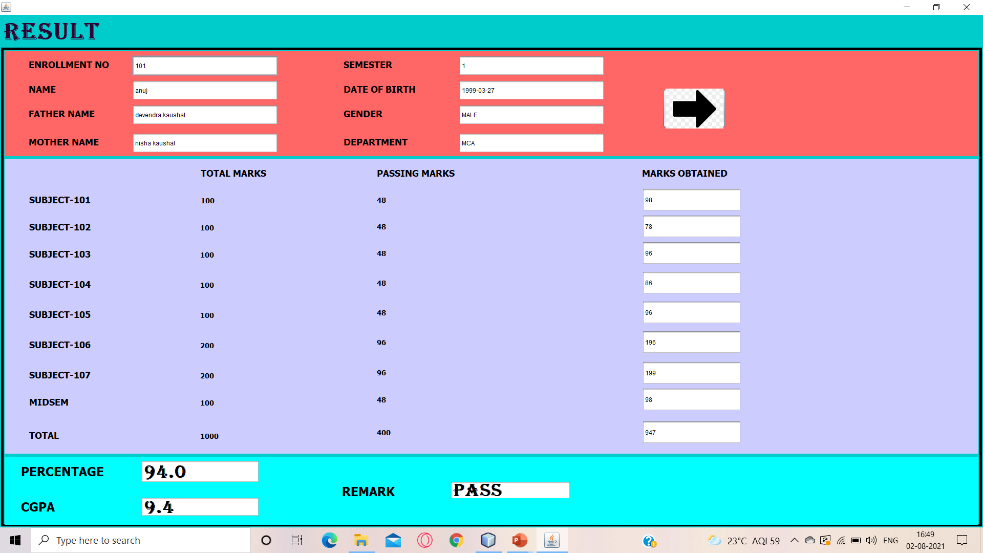
RESULT PAGE :-

Slide 18
CONCLUSION:-
The project titled ‘RESULT PROCESSING SYSTEM’ was developed to generate the result of students.
All the necessary output was created.
The system was found to be user-friendly to both students and admins.
The Architecture of the project provide an easy to use environment for the users.
The system was implemented successfully.
The manpower and the working hours needed to operate the system was less and comfortable.
It was seen to be more secure and effective.

Slide 19
BIBLIOGRAPHY :->
https://www.javapoint.com
https://www.youtube.com
https://www.w3schools.com
https://www.learning.tcsionhub.in
https://www.google.com
https://www.greaksofgreaks.com

Slide 20
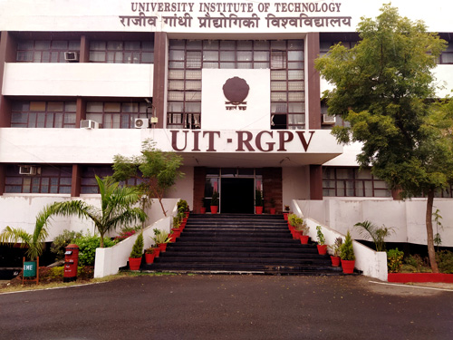
THANKYOU FOR YOUR ATTENTION

